Slide 2
Restoration of the Church
By using the Internet, as a means to pray and connect worldwide, the Restoration of the Church in these challenging times is implementing God’s purposes and ultimate plan.
First, God’s people regroup around the Holy Spirit’s uplifted standard of Jesus Christ.
Second, God’s people delivered from demonic influence.
Third, God’s people are re-equipped with supernatural power of the Holy Spirit.
And Fourth, God’s people re-gathered and joined together in a unified body (Body of Christ).

Slide 3
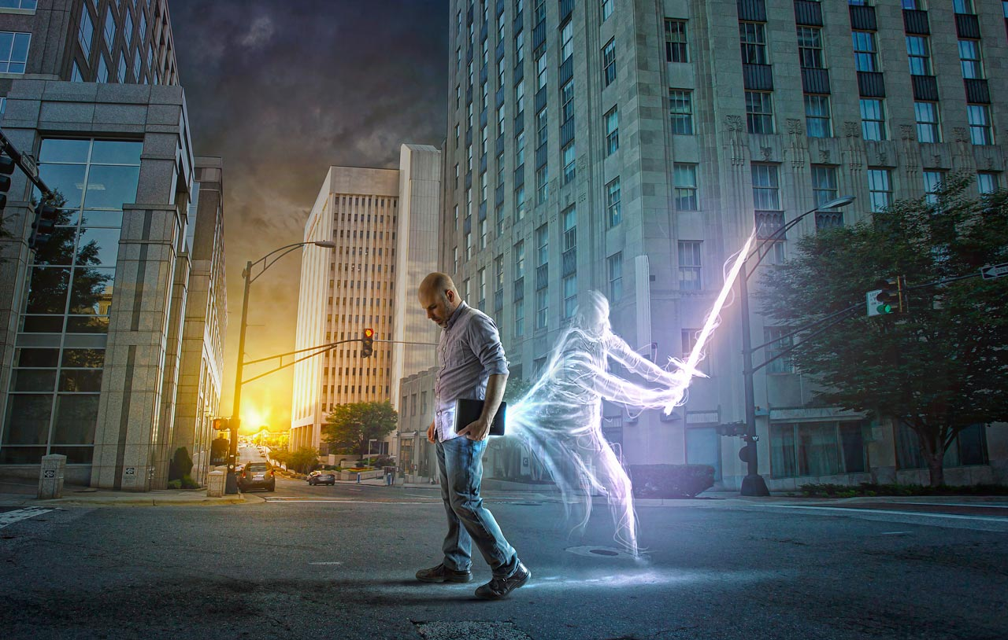
BINDING AND LOOSENING PRAYER:
BIND: Mammon and Greed | LOOSEN: God’s Provisions and Prosperity
BIND: Pride and Rebellion | LOOSEN: True Humility and Surrender
BIND: Lust and Perversity | LOOSEN: Purity and Honor
BIND: Deception and Corruption | LOOSEN: Honesty and Trustworthiness
BIND: Infirmity and Poverty | LOOSEN: Health and Provisions
BIND: Spirit of Anti-Christ | LOOSEN: Truth of Jesus Christ
BIND: Government Corruption | LOOSEN: One Kingdom under God

Slide 4
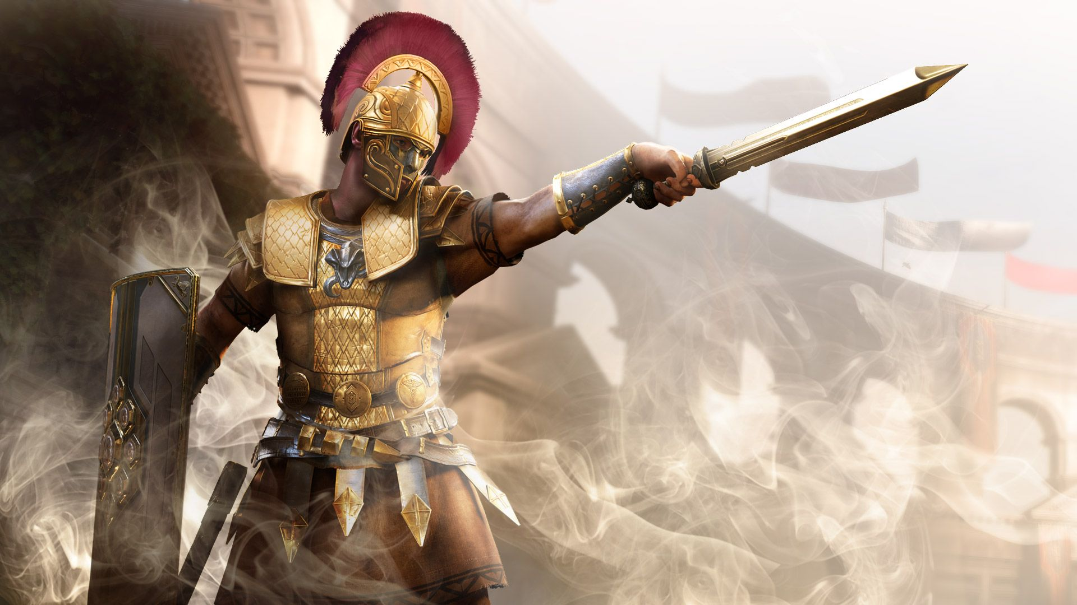
TARGETED, PERSEVERING, PREVAILING PRAYER FOR THESE DAYS:
GOOD GOVERNMENTS – targeting all those in leadership positions in counties, cities, states, provinces, and nations. Men and Women anointed and appointed of God. | GOOD SCHOOLS – targeting all teachers, administrators, facilitators, and school boards be anointed and appointed by God-centered leaders and based on Biblical principles and absolute truth in teaching.
FAMILIES – casting out the divisive strategies of the enemy in whatever form it may try to manifest. Restoration of relationships for the entire family. No one left behind. | CHURCHES – targeting deceptive and apostate teachings to be clearly revealed and God’s justice manifested. Giving Glory to God, the Father, His Son Jesus Christ, and the Holy Spirit, ONLY!
HEALTH CARE INDUSTRY – Physicians, nurses, practitioners, therapists, administrators, and pharmacists provide safe and effective healing. Never to harm life in any way. | NEWS AND MEDIA – truth, the whole truth in news, and quality God-fearing programming that promotes healthy educational standards bringing unity and never division.

Slide 5
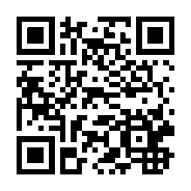
“Fighting the good fight of faith in Jesus Christ one-day-at-a-time.”
facebook.com/prayerwarriors365
youtube.com/user/prayerwarriors365
twitter.com/prayerwarriors6
instagram.com/pws365/
linkedin.com/company/gnbm
pinterest.com/prayerwarriors/prayer-warriors-365
contact@prayerwarriors365.com
Good News Broadcasting & Multimedia, Inc.♦ P.O. Box 132733 ♦ The Woodlands, Texas 77393-2733

